Slide 1

Visitor Control Center SharePoint

Slide 2
Contents
Home Page
Submissions
Visitor Passes

Slide 3
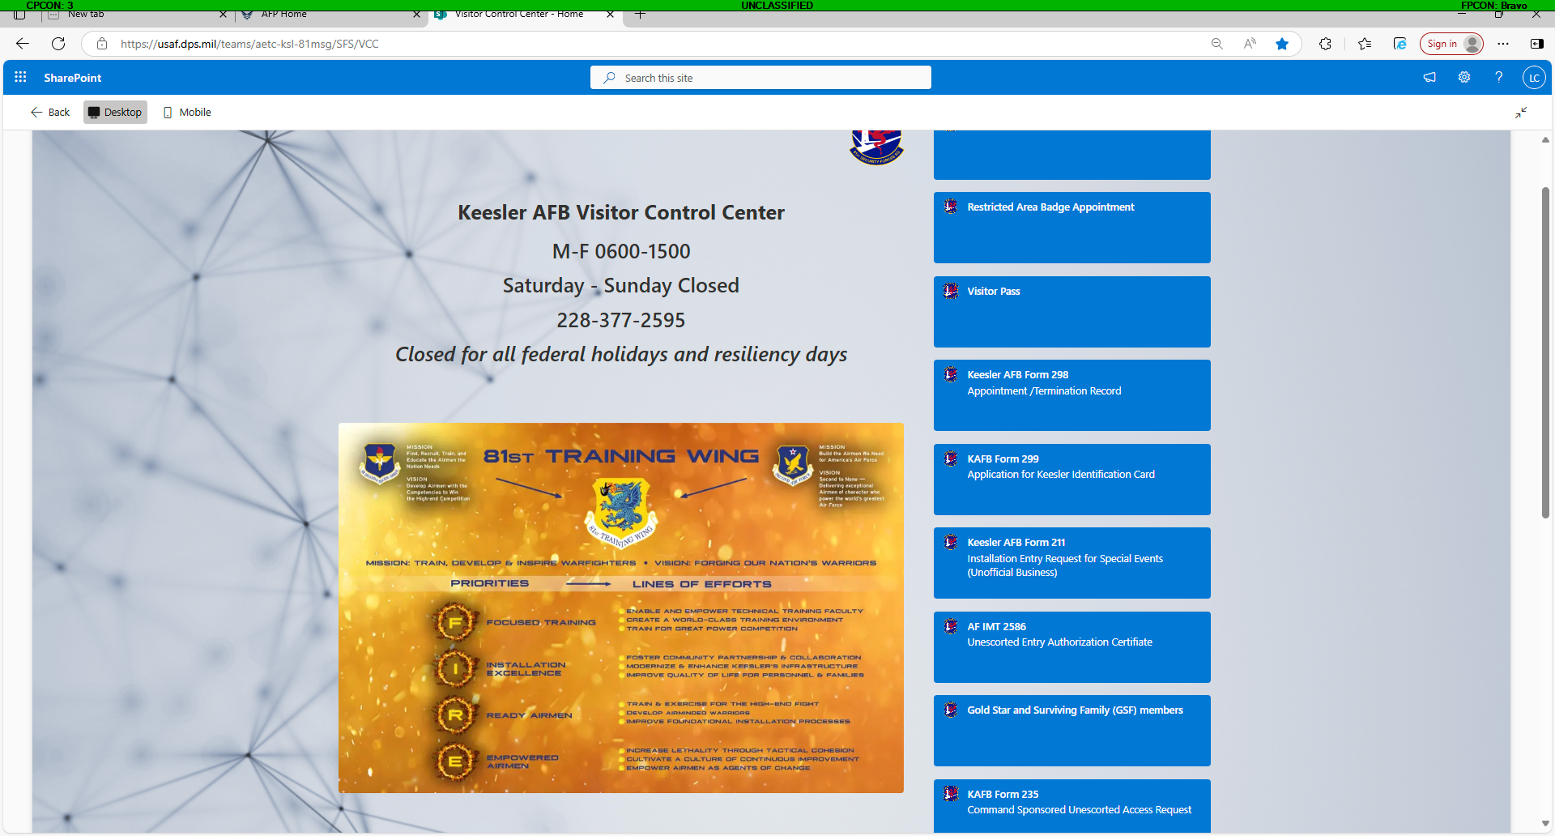
Home Page
Welcome to the new VCC Sharepoint!
The home page will be the link for all forms handled by the Visitors Center to include visitor passes.
You can search through Commonly Asked Questions prior to reaching out to VCC personnel. We will continue to update this section to address the needs of the installation.
Security Managers! All restricted area badge appointments can now be made through this site.
(Tues & Thurs 0800-1600)
Forms that may be submitted through this site include: Visitor Passes, Keesler AFB Form 298, Keesler AFB Form 299, Keesler AFB Form 211, AF IMT 2586 and Keesler Form 235
Additional information provided for Real ID requirements and Eligible Veterans and Caregivers procedures
CLICK BELOW!
Visitor Control Center - Home

Slide 4
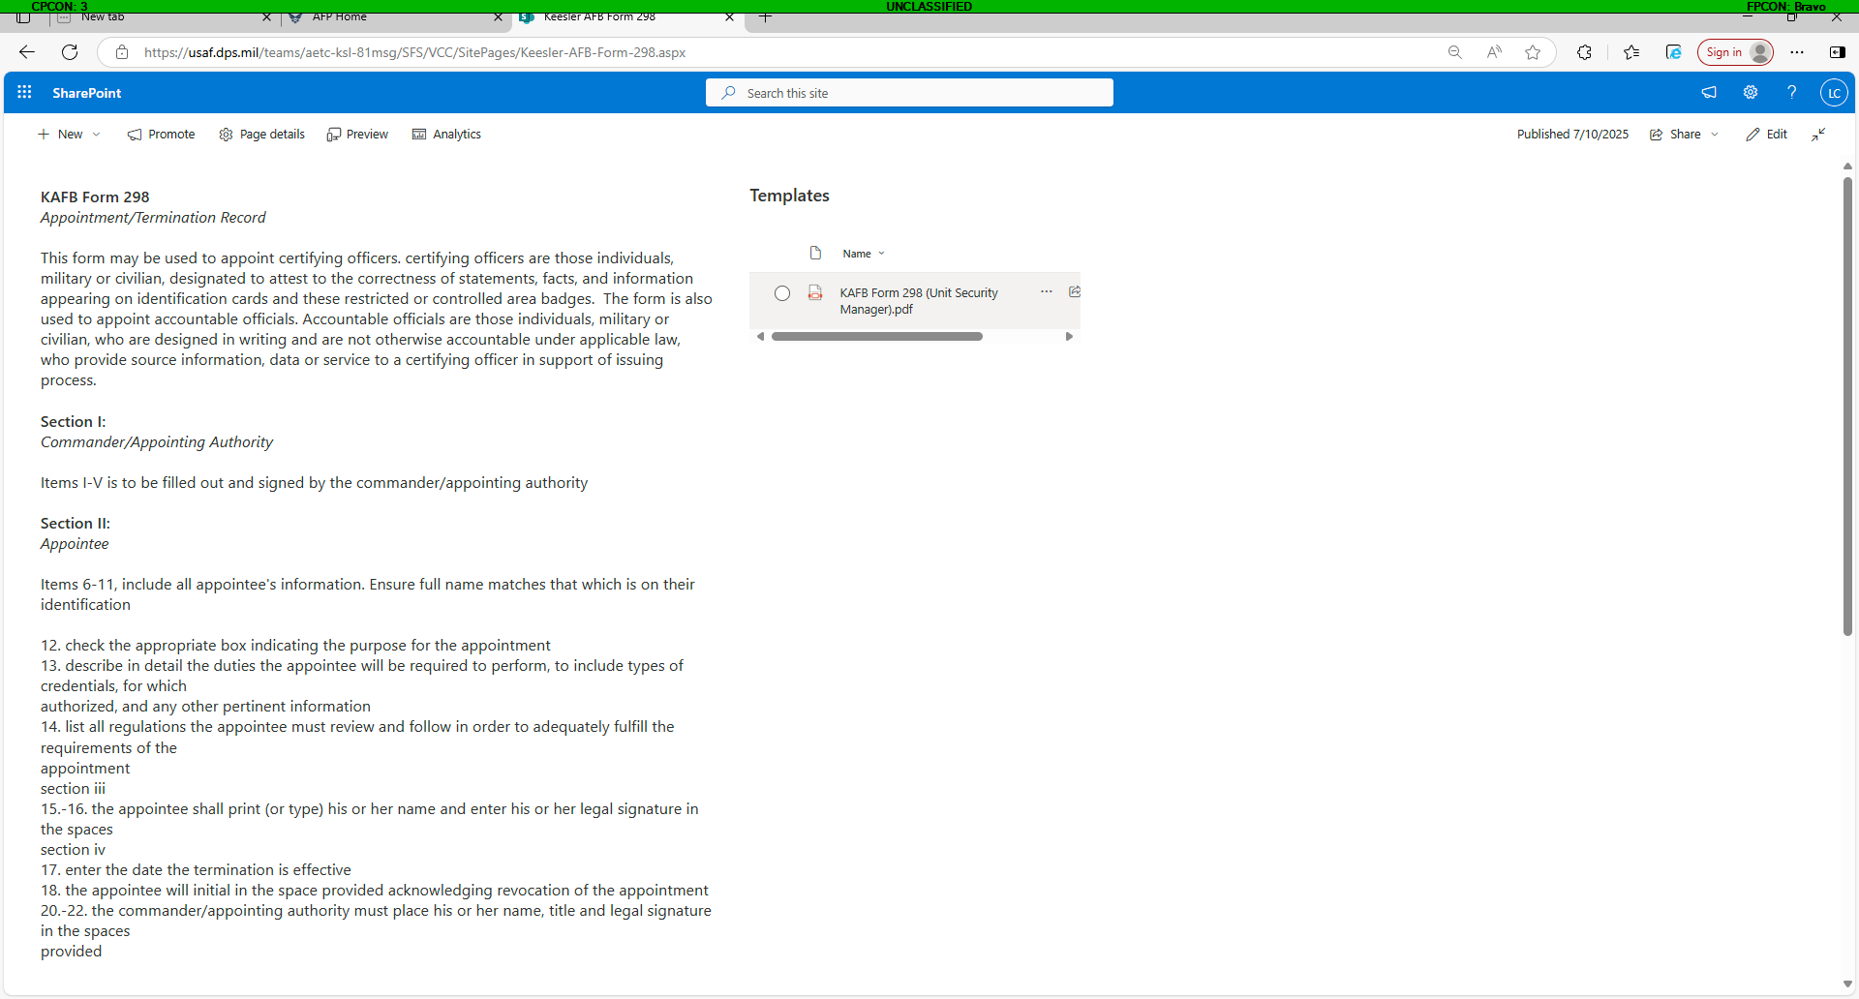
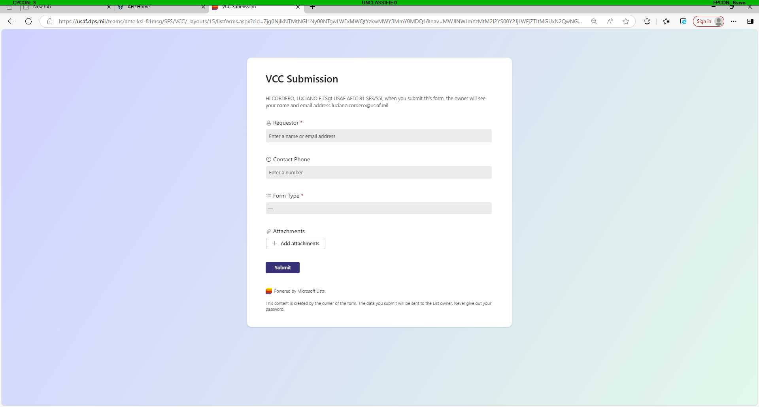

Submission
Welcome to the new VCC Sharepoint!
When submitting a form, you can click on any of the links on the righthand side.
You will be brought to a page dedicated to that specific form which will provide all the details needed to submit the form correctly.
Once you’ve completed the form you can scroll to the bottom of the page and “Click To Submit”
You will be taken to an additional page to submit your form
Provide you name, phone number, form type and attach your form here
Form included to download

Slide 5
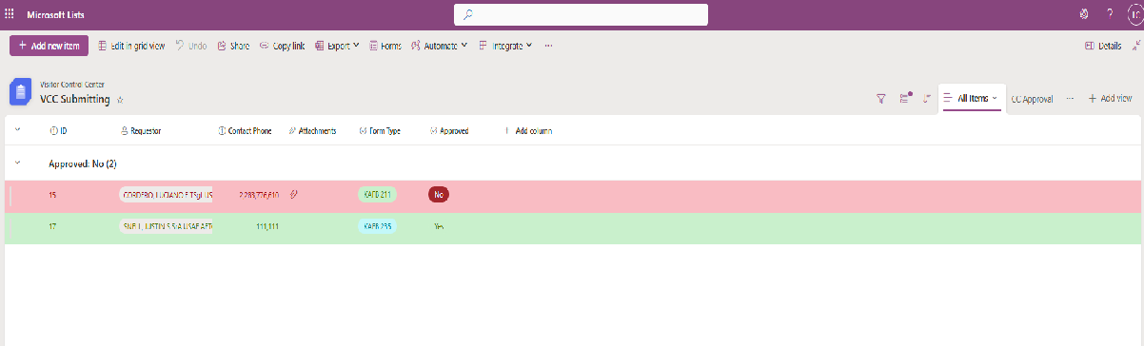
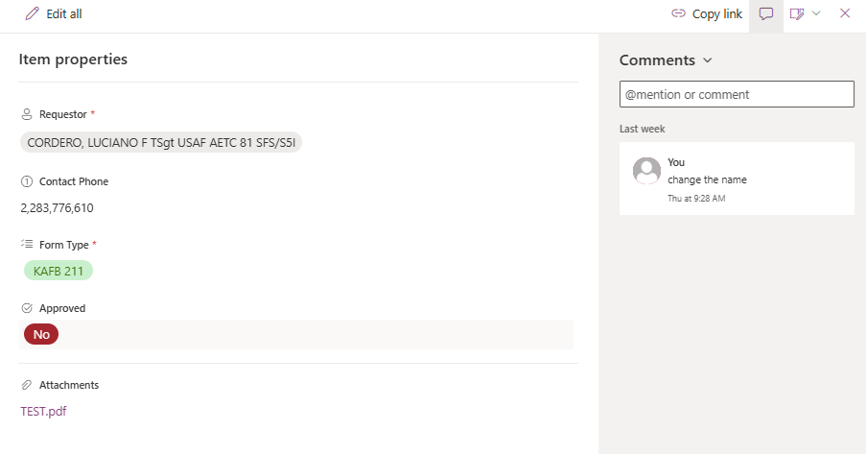
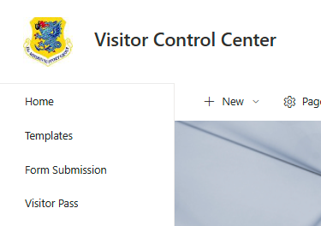
Submission (Continued)
Once you submitted your form, you will be taken to the Form Submission Page (Image 1)
You will only be able to see the form you submitted. Initially it will appear RED, but once it’s been approved by VCC personnel, it will appear GREEN.
If there are issues, VCC personnel will make comments seeking corrections. You can view comments by double clicking on your form and a text box will appear (Image 2)
Corrections can be made, old form removed and an updated form attached. Add “UPDATED” to the file name when attaching a new form.
After submission, you can return to the homepage and click on “Form Submission”
This will return you to the submission page where you can see the current status of your form.
Image 1:
Image 2:

Slide 6
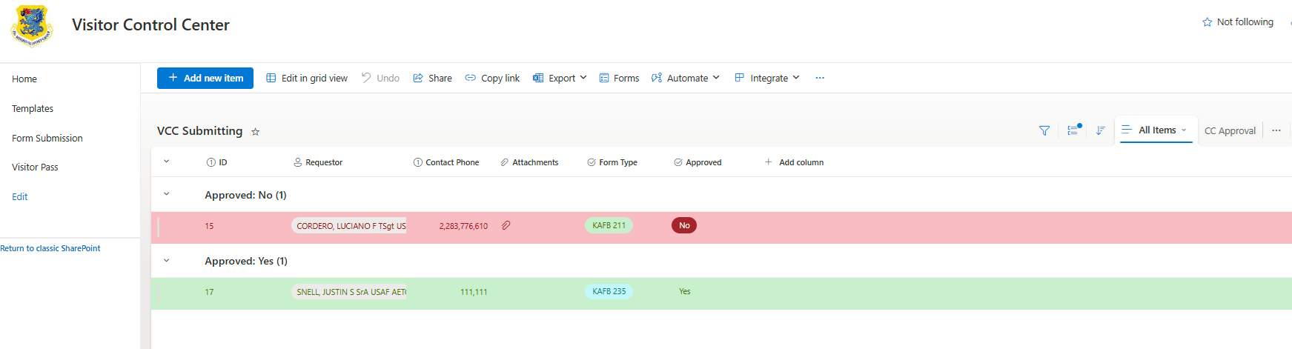
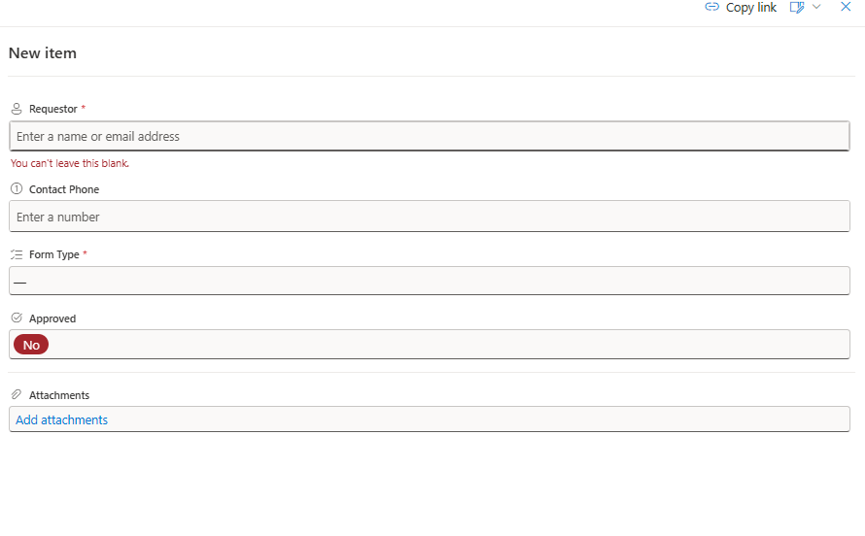

Submission (Continued)
Until a solution is created, some personnel will not be able to use the “Click to Submit” link. These personnel can click “Form Submission” from the top left of the home page:
They will be taken to an additional screen (Image 1)
Once on this screen you can click and a
pop-up screen will appear (Image 2)
You will fill out your name, contact number, phone type and attach your form.
DO NOT alter the approved block. This could delay processing on your form or cause it to be overlooked if categorized incorrectly.
Image 1:
Image 2:

Slide 7
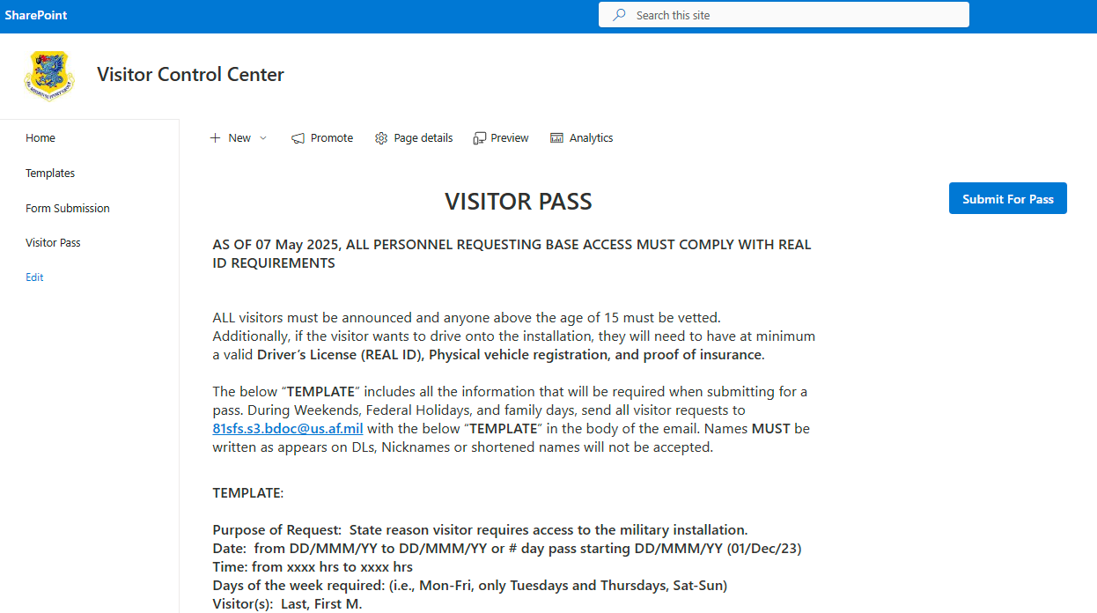

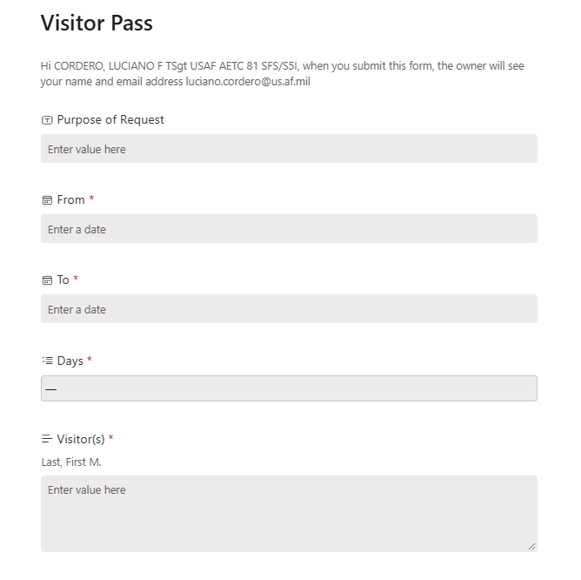


Visitor Pass
When submitting a Visitor Pass just click on the Visitor Pass link on the right
You will be brought to page dedicated for visitor passes which will provide details needed to submit along with the process for weekends and holidays. (Image 1)
When ready, just click
You will be brought to an additional page (Image 2) where you will enter all the required information than click
Image 1:
Image 2:

Slide 8
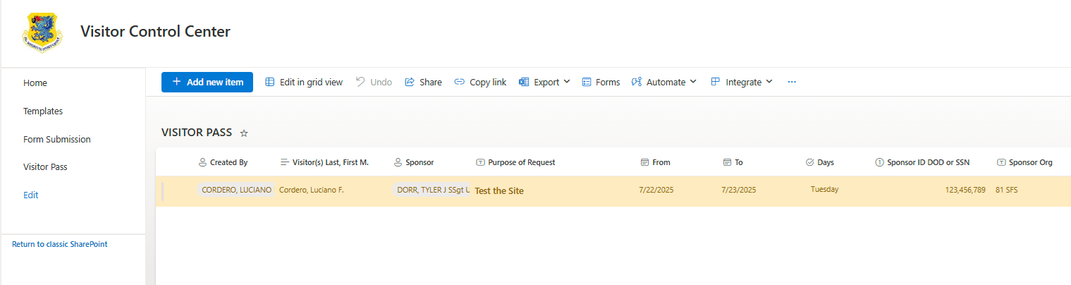
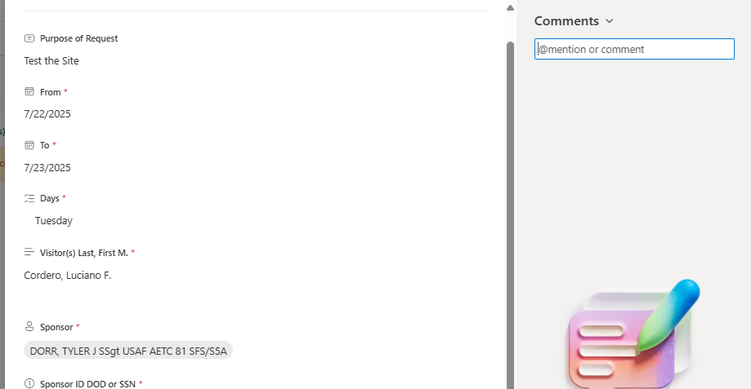
Visitor Pass (Continued)
Once you submitted your form, you can return to the home screen and click “Visitor Pass” on the top right:
to be taken to the visitor pass submission page (Image 1)
You will only be able to see the pass you submitted.
  Initially it will appear YELLOW (pending), but once it’s been approved by VCC personnel, it will appear GREEN if they were approved/issued or RED if it’s denied/needs additional information.
If RED you can double click your request for an additional pop-up screen (Image 2). VCC personnel will enter a quick note but will not release any personnel information
If RED and resolvable, sponsors will currently need to resubmit a visitor pass request through the home page.
Image 1:
Image 2:

Slide 9
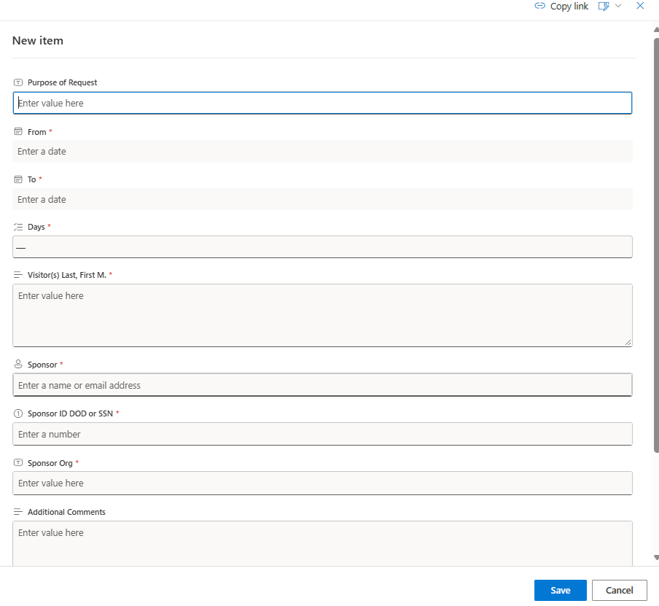
Visitor Pass (Continued)
Until a solution is created, some personnel will not be able to use the link. These personnel can click “Visitor Pass” from the top left of the home page:
They will be taken to an additional screen (Image 1)
Once on this screen you can click and pop-up screen will appear (Image 2)
You will fill out all required information.
DO NOT alter the approved block. This could delay processing on your form or cause it to be overlooked if categorized incorrectly.
Image 1:
Image 2:

Slide 10
Questions?
Email: 81sfs.s5.plansprograms@us.af.mil

